Slide 1
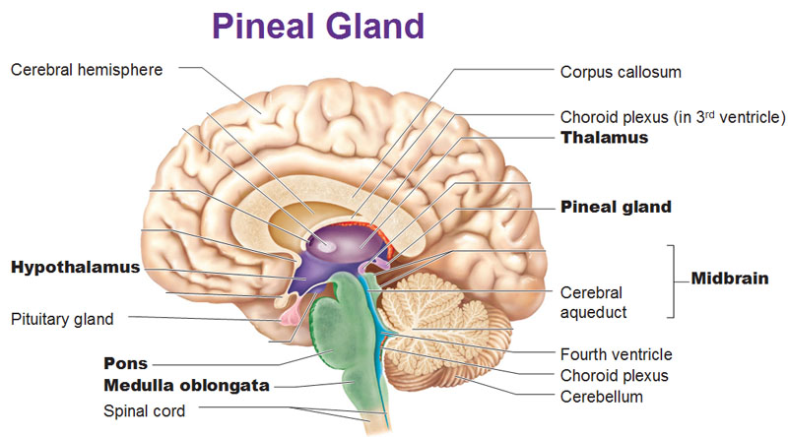
Esoteric Role of the
Pineal Gland
By: Vishal Rawat

Slide 2
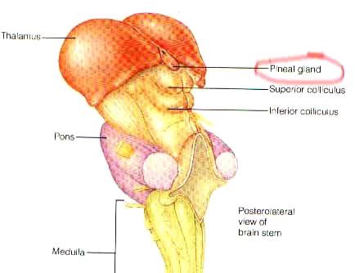
Description
- The Pineal Gland is the smallest functional gland in the human body
- It is located between the cerebellum and the thalamus
- The gland is .25 inches long, which is about the size of a grain of rice, and weighs 100 mg
- It is conical in shape which makes it easy to fit into a groove where two rounded thalamic bodies join
- Also it is connected with the upper layer of the third ventricle

Slide 3
Description (cont.)
- The pineal gland consists of five different cell types
- Pinealocytes produce the hormone melatonin and consist of a cell body with 4-6 processes emerging
- Interstitial cells are located between the pinealocytes
- Perivascular phagocytes are located near the capillaries and they are antigen presenting cells
- In some higher vertebrates neurons are located in the pineal gland called pineal neurons
- Peptidergic neuron-like cells are located in some species
- They would serve a paracrine regulatory function

Slide 4
Function
- The pineal gland is one of the glands neurologists consider to be the master gland, including the pituitary gland
- It is one of most important glands in the endocrine system
- The pineal gland plays a key role in the manifestation of consciousness-force
- It also regulates the cycle of the biochemical activities in an individual
- It provides linkage between the body and mind
- Rene Descartes, a French philosopher, describes the pineal gland as the connection between the jaḍa and the chetanā
- The jaḍa is the material component of the body and the chetanā is consciousness power of the mind

Slide 5
Function (cont.)
- Divine consciousness inspires one’s mind through the extrasensory energy-nucleus
- The energy nucleus, also referred to as the agyā chakra in yoga- science, governs intuitive experience
- The pineal gland secretes a hormone, melatonin, which reacts with darkness and maintains the circadian biorhythms
- Circadian biorhythms are daily activity cycles that are based on a 24-hour intervals such as sleeping and walking in humans
- Also it is associated with cyclic transitions of day and night
- The hormone melatonin affects activities of neurons which control the process of sleeping

Slide 6
Research by Scientists
- Greek Physician Herophilus described the pineal gland as the regulator of the thought process sometime in 400 BCE
- Dr. Crookshak did numerous amounts of research on the endocrine system
- His work has made significant contribution in identifying the effects of the endocrine glands on physiology and psychology
- In his perspective the corporeal and intellectual health of an individual and his integral propensities could be assessed in terms of the level and pattern of hormonal secretions in the endocrine system.”
- Two micro anatomists, Dr. H.W. Graft and Dr. E. Baldwin Spencer carried out experiments which shows that the pineal gland responds to the optical signals received from the surroundings of a human

Slide 7
Spiritual Role
- The pineal gland is considered to be directly connected with the āgyā chakra (third eye)
- If the third eye is awakened it awakens viveka, which is prudence, wisdom, and righteous thinking
- Viveka gradually evolves into spiritual insight after the third eye is awakened
- If the person channelizes their creative talents, intelligence and virtuous potentials with the support of viveka, then he can find and use the otherwise hidden treasure of the unconscious mind
- The awakened āgyā chakra purifies and illuminates the core layers of conscious, subconscious and unconscious mind, intellect and inner self

Slide 8
Spiritual Role (cont.)
- Purifying and illuminating the core layers of mana, buddhi, chitta, and ahaṁkār is a fundamental step in the sādhanā of manomaya kośa
- The mind can be restrained and refined by the sādhanās of opening of the āgyā chakra
- In the Purāṇas it is mentioned, “The burning of Kāmadeva because of the opening of the third eye of Lord Shiva”
- It is an allegoric reference to show that the pineal gland, when activated, opens the third eye
- If the āgyā chakra’s power is refined it can open up the ways of sublime transformation

Slide 9
Pineal Gland Extra
- It has been proven that as you grow older your pineal gland decreases in size
- It is based on emotional levels, a child would have a bigger pineal because he/she is more emotional
- The pineal gland is more developed and larger in people with spiritually elevated personalities and people that are more compassionate
- These type of people have more spiritual potential to attain the sublime levels of chetanā
- Once the pineal gland is awakened it induces elevated flow of prāṇa which is vital spiritual energy

Slide 10


Conclusion
- Many great people around the world were empowered by the internal energy and strength of their vital force
- They used their talents for higher ideals with the help of their viveka
- Their lives were endowed with such accomplishments that could be likened to divine boons

